Slide 1
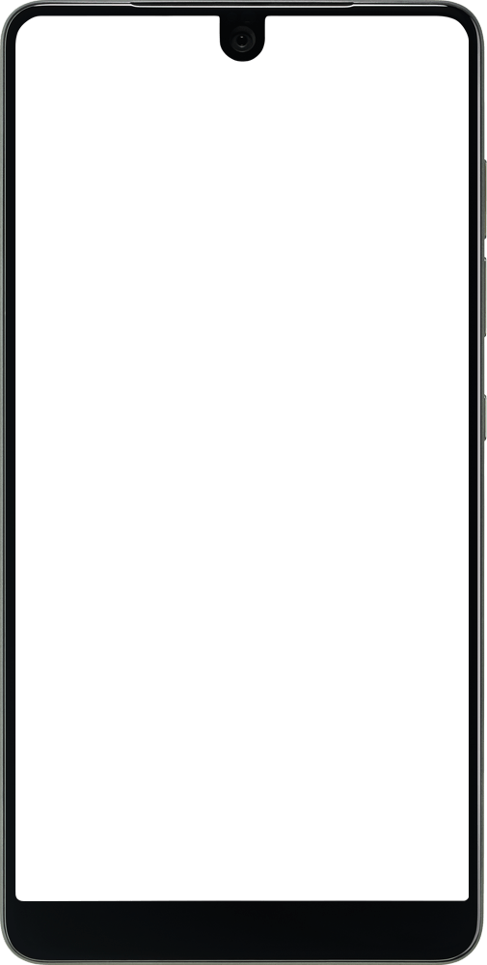

Getting Started with Android App Development in Kotlin
[ INTRODUCTORY SESSION 01 - GDSC BU ]

Slide 2
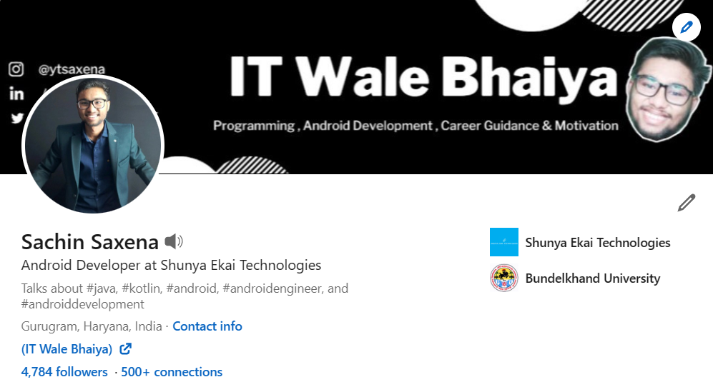
SACHIN SAXENA
WHO IS THIS ALEIN 👽 ?
- IT WALE BHAIYA
MCA (2020-2022) - BU

Slide 3
AAJ KA AJENDA
01
02
03
04
05
06
Introduction
Why Kotlin ?
Tools 🔨
Things You Should know Before Start Android Development
Resources &
Practice
QnA / Future of Android / Market Trends

Slide 4


Slide 5

Raise your hand up if u knew any Programming Langugae ?
OOPs Based / Modern Programming Language
C++ / Java / Kotlin / Python / JavaScript etc

Slide 6

When Some one Said :
HTML is a Programming Language
Notes:
Modern Programming languges - Java ,Kotlin , C++ , Python , (OOPs Based Language ) etc

Slide 7

Introduction
1. Learn Kotlin as a Language First.
2. Deep Dive into Android Dev
Notes:
Learn Kotlin as lang - kyu seekhna hai sytntax , oops

Slide 8
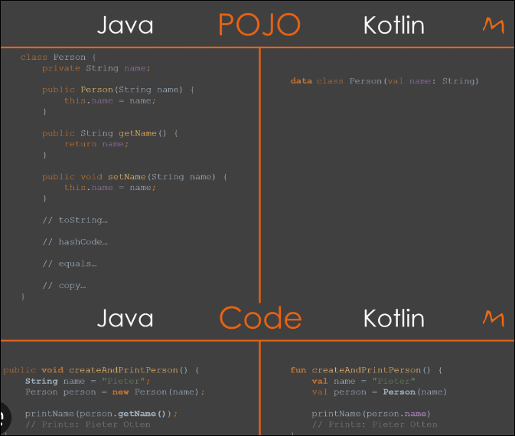
Why no JAVA
in 2023 ?
*For Android Dev

Slide 9



Tools to Start Android Dev
High Config Laptop / PC
Android Studio IDE
Good Internet Connection
Atleast 8 GB RAM PC/LAPTOP
with a Good Processor + (SSD) - Graphic (Optional)
Official IDE for Android Development
You need to download lot of Gradle Files / 3rd Party Dependencies / etc

Slide 10


Things You Should know Before Start Android Development
> There are 2 things in Android
UI
DESIGN
BUSINESS
LOGIC

Slide 11


Slide 12
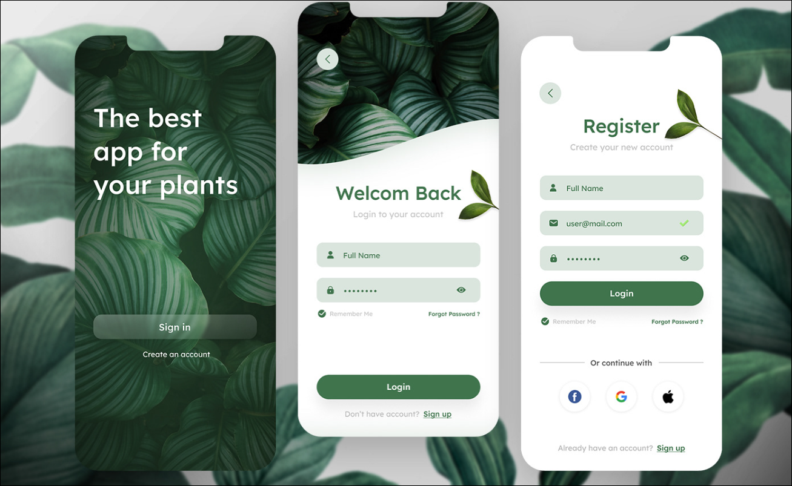
SPLASH SCREEN
LOGIN SCREEN
REGISTER SCREEN

Slide 13
Resources to Learn Android Development (FREE)

Slide 14
Raise your hand u are?
I can learn through Blog /Article/
Documnetation
i can understand through Videos
B
A

Slide 15
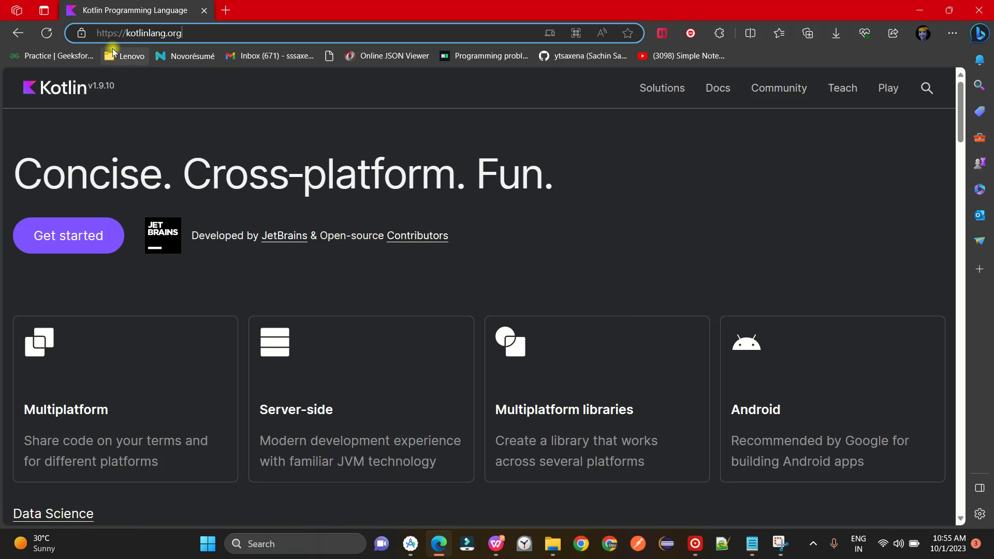
Learn

Slide 16
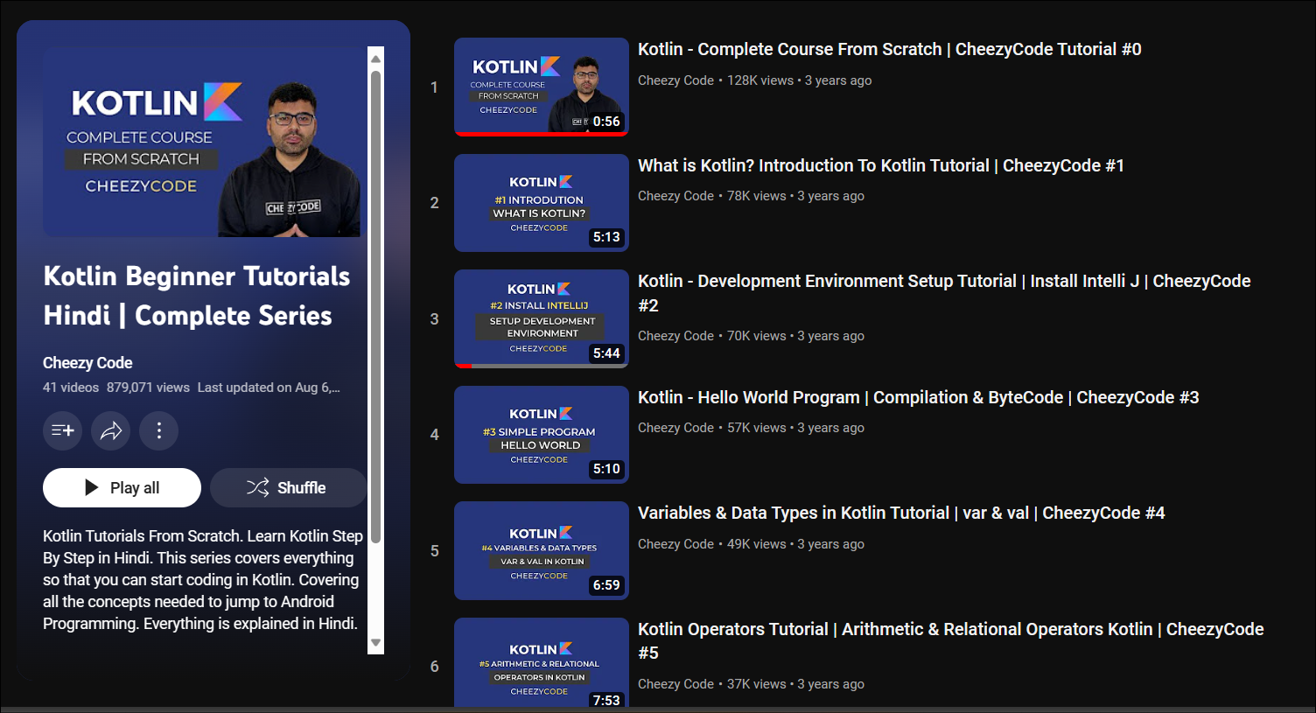
Learn

Slide 17
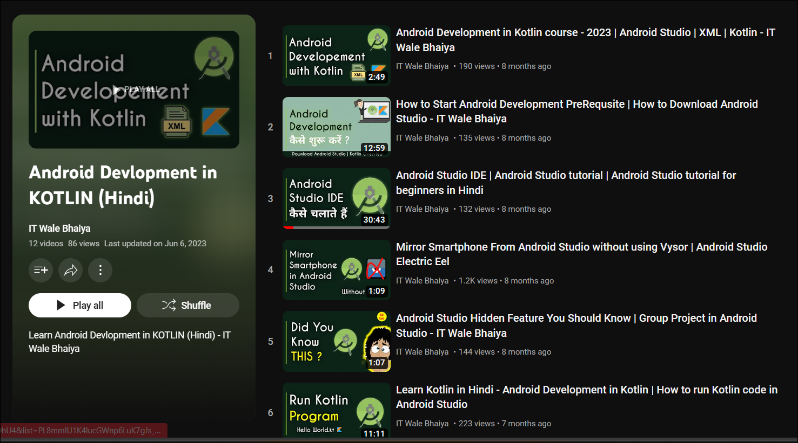
Learn

Slide 18
Links to visit
https://kotlinlang.org/docs/kotlin-tour-hello-world.html
https://www.youtube.com/watch?v=NosAkIKgA4Y&list=PLRKyZvuMYSIMW3-rSOGCkPlO1z_IYJy3G
https://www.youtube.com/playlist?list=PL8mmlU1K4lucGWnp6LuK7gJs_Kq_qvsik
Follow the links

Slide 19
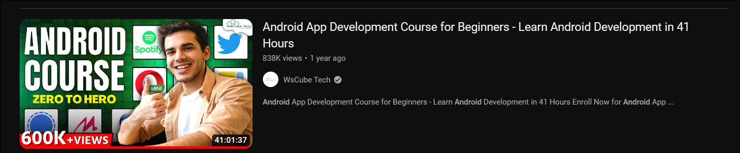
Points to Remember
Learn Kotlin (Practice it in Android Studio)
Install Android Studio
Learn UI Design in XML ( Jetpack Compose ) , Learn Android Concepts
Start making APPs , Practice...Practice...Practice......
Follow this link : https://www.youtube.com/watch?v=u64gyCdqawU

Slide 20

When you started u will feel Hard sometimes u failed , But Dont STOP , Try Again , you can ...
Like when you Install Android Studio IDE
How to use Android Studio
How to Install (.apk) on Smartphone
How to resolve Gradle errors
Ask Your Doubts & Queries in Telegram Open Chat community
https://t.me/gdsc_bu23telegram

Slide 21

Lets Dive.........

Slide 22

I Hope , You all Enjoyed this Session...😄😄
Learning Android 📱🔥 is Fun

Slide 23
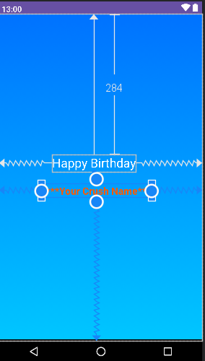
Assignment to Do
> Install Android Studio IDE in your Machine
> Create a new Project (Happy Birthday)
> Create a Birthday APP UI
( Happy Birthday *Your CRUSH NAME * )

Slide 24
Thank you for Joining
Social Links : Reach out here
Linkedin : Sachin Saxena
Youtube : @ITwalebhaiya
Instagram : @ytsaxena
Twitter : @sachins69358685

